Slide 1

Phase 2:
Flight Delay Prediction
04.01.25
SECTION 3, TEAM 1
Members: Sebastian Rosales, Kenneth Hahn, Benjamin He,
Edgar Munoz, Adam Perez,
Kent Bourgoing
Notes:
AUTHOR: ADAM
Imagine rushing through a crowded airport only to arrive at your gate and discover that your flight has been delayed. Flight delays represent a persistent and disruptive challenge in air travel, adversely affecting travelers' experiences worldwide.
Given the substantial volume of data generated by air traffic operations, this project aims to address the challenge by developing a flight delay prediction model within a distributed framework.
But before we cover the components of the project in more detail let’s first meet the team behind it….

Slide 2

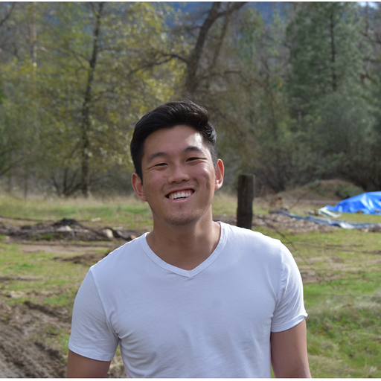




Group Members
Sebastian Rosales
sbsrosales11@berkeley.edu
Kenneth Hahn
hahnkenneth@berkeley.edu
Benjamin He
ben_he@berkeley.edu
Edgar Munoz
edgarmunoz@berkeley.edu
Adam Perez
adperez@berkeley.edu
Kent Bourgoing
kent1bp@berkeley.edu
Notes:
AUTHOR: ADAM
The team is made up of 6 members. We have Sebastian, Kenneth, Benjamin, Edgar, Kent, and myself.

Slide 3
1.
Project Description
2.
Exploratory Data Analysis
3.
Preprocessing/Pipeline
4.
Cross-Validation and Fine-Tuning
5.
Model Results
6.
Conclusion
Notes:
AUTHOR: ADAM
Today, we’ll first start by covering some of the complexities of the problem while also talking through some of the potential business implications of enhancing overall travel reliability.
Next we’ll discuss the data sources– along the way, highlighting how we've used our understanding of the domain to help inform our exploratory data analysis.
Following that, we will outline our preprocessing pipeline and discuss our approach to validating model efficacy using Time Series Cross Validation.
Lastly, we will present detailed model results.

Slide 4
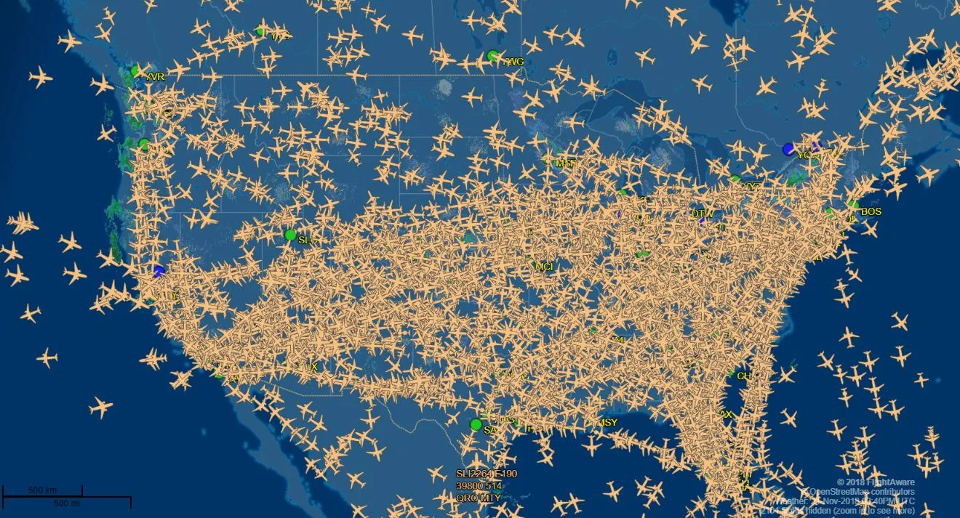
Background
Science Presentation
Air travel is a complex web of logistics that needs to be handled precisely in order to coordinate departures and arrivals for 45,000 flights and 2.9M passengers per day.
It is beneficial for both airlines and for passengers to be able to predict whether a given flight will be delayed or not for a variety of reasons:
Operational Efficiency: optimizing crew scheduling, ground handling, and gate assignments.
Customer Satisfaction: Allows for airlines to notify customers ahead of time to reduce stress and allow them to plan ahead.
Notes:
AUTHOR: ADAM
Air travel operates within a highly complex system and requires precise synchronization across many interconnected activities. This intricate logistical network coordinates approximately 45,000 flights and manages 2.9 million passengers daily. Within this environment, accurately predicting flight delays holds substantial value.
For airlines, the ability to anticipate delays improves the efficiency of their operations by allowing proactive management of crews, gate assignments, and ground resources – minimizing disruptions and optimizing resource allocation.
For passengers, timely predictions regarding delays significantly improve customer satisfaction since it allows travelers to plan effectively, reduce stress, and manage their expectations accordingly.

Slide 5
Goal
Utilizing flight data provided by the U.S. Department of Transportation and meteorological data provided by the National Oceanic and Atmospheric Administration repository (NOAA), our goal for this project is as follows:
Classify and predict flight departure times ahead of the scheduled flight to determine whether a given flight will depart early, on-time, or late.
Notes:
AUTHOR: ADAM
Leveraging flight data sourced from the U.S. Department of Transportation, in combination with meteorological data obtained from NOAA, we set out to accurately anticipate departure times by developing a predictive classification model to determine whether a flight departure will occur early, on-time, or be delayed.
We believe this can provide value in many ways:
With the results of early predictions we enable airport operations crews and airlines to proactively optimize maintenance schedules, cleaning routines, and air-traffic management, significantly enhancing operational efficiency.
Similarly, accurately forecasting delayed departures provides passengers and airline staff critical insights, allowing them to plan accordingly and minimize disruptions to travel plans.
With both the goal and value of our project in mind, I am now going to pass it off to Sebastian to talk in more detail about how we systematically explored the datasets.

Slide 6
1.
Project Description
2.
Exploratory Data Analysis
3.
Preprocessing/Pipeline
4.
Cross-Validation and Fine-Tuning
5.
Model Results
6.
Conclusion

Slide 7
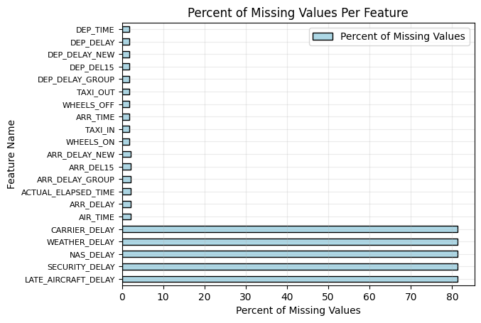
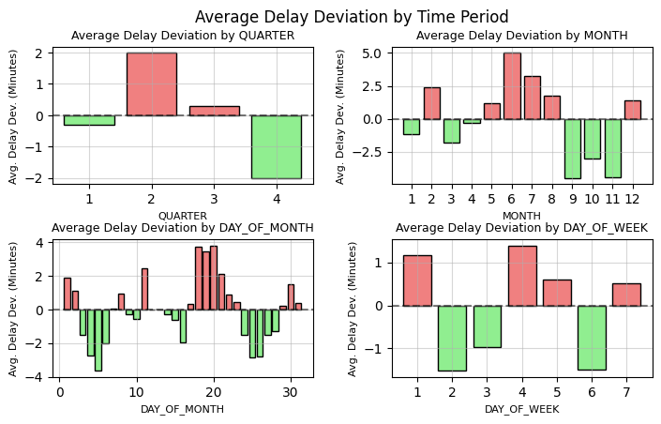
Flights Dataset
Has 109 columns with 14,844,074 rows
48 columns had a missing value percentage above 95%
40 columns had a missing value percentage below 1%
Quarter 2 seems to be the worst time to travel
However, most of the flight delays are from the month of June
Day of the month and week can help us pick the best days to travel
Notes:
AUTHOR: SEBASTIAN

Slide 8
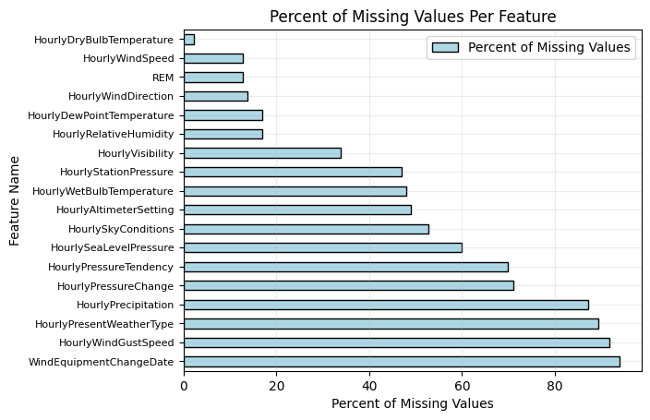
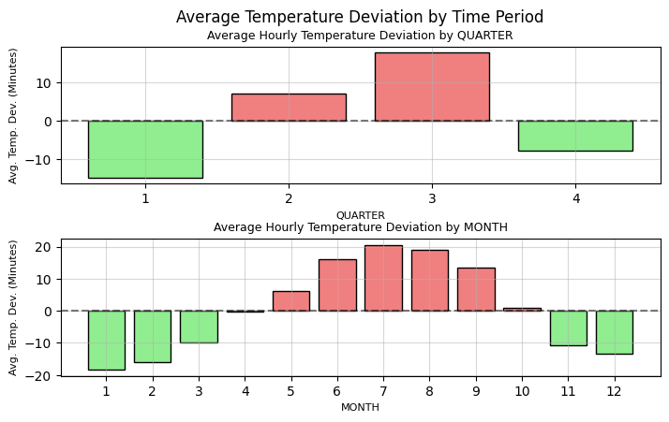
Weather Dataset
Has 124 columns with 131,937,550 rows
97 columns had missing value percentages above 95%
9 columns had missing value percentages below 1%
Conducted a quick sanity check to ensure our data makes sense
Notes:
AUTHOR: SEBASTIAN

Slide 9
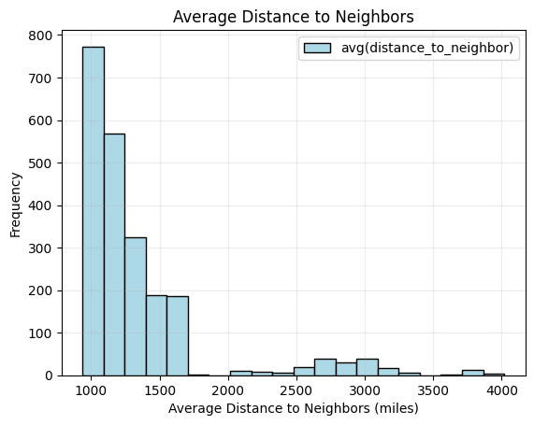
Airport Dataset
Has 12 columns with 5,004,169
There were no missing values on all 12 columns
Most airports are on average 1000 to 1500 miles away from another airport
There are some airports that are on average nearly 4000 miles away from another airport
Could be help us predict delays since there might be greater delays when traveling further distances
Notes:
AUTHOR: SEBASTIAN

Slide 10
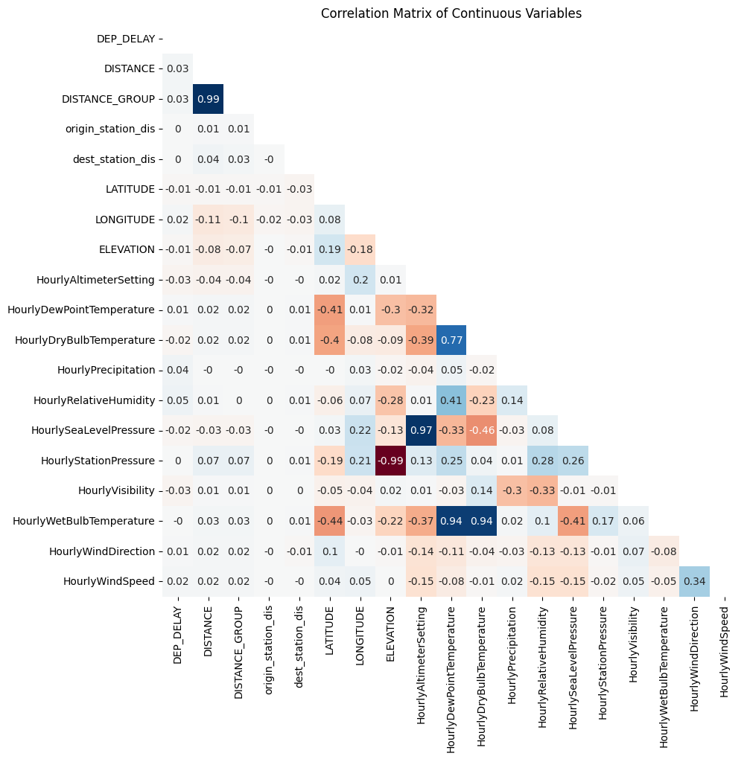
Numerical Analysis
Strong negative correlations:
ELEVATION and HourlyStationPressure
Strong positive correlations:
DISTANCE and DISTANCE_GROUP
HourlyAltimeterSetting and HourlySeaLevelPressure
HourlyDewPointTemperature, HourlyDryBulbTemperature, and HourlyWetBulbTemperature
From 3-Month to 12-Month LONGITUDE lost all of its correlation to temperature features
Notes:
AUTHOR: SEBASTIAN

Slide 11
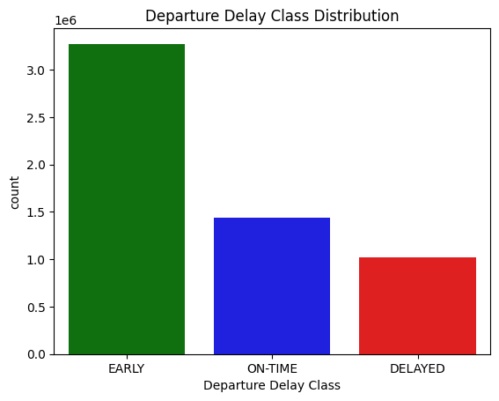
Target Variable Analysis
We are interested in classifying 3 classes
Early (Delay < 0 minutes)
On-Time (0 <= Delay <= 15 minutes)
Delayed (15 minutes < Delay)
Chose 15 minutes as Delayed based on the definition from Department of Transportation
Early is by far our majority class representing 57.2% of flights
On-Time is the second most common occurrence representing 25.1% of flights
Delayed is the rarest occurrence representing 17.8% of flights
Notes:
Discuss class imbalance from 2-class classification versus 3-class classification
AUTHOR: SEBASTIAN

Slide 12
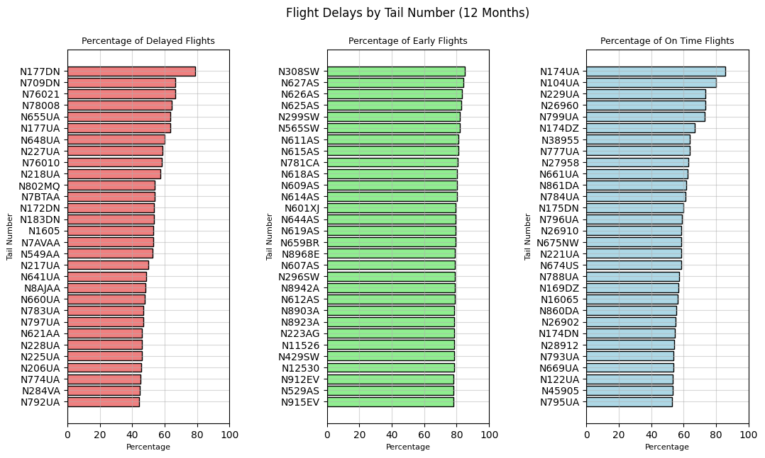
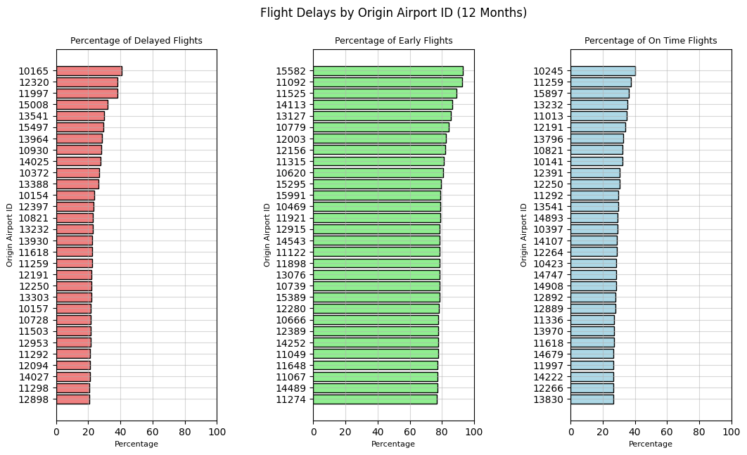
Categorical Analysis
Tail numbers might be indicative of how reliable an aircraft is
Some are highly reliable with early flight percentages around 80%
Some are highly unreliable with delayed flight percentages around 50%
Efficient airport designs and less travelers might make smaller delays more consistent
The 30 airports shown had an early flight percentage above 75%
Notes:
AUTHOR: SEBASTIAN

Slide 13
1.
Project Description
2.
Exploratory Data Analysis
3.
Preprocessing/Pipeline
4.
Cross-Validation and Fine-Tuning
5.
Model Results
6.
Conclusion

Slide 14
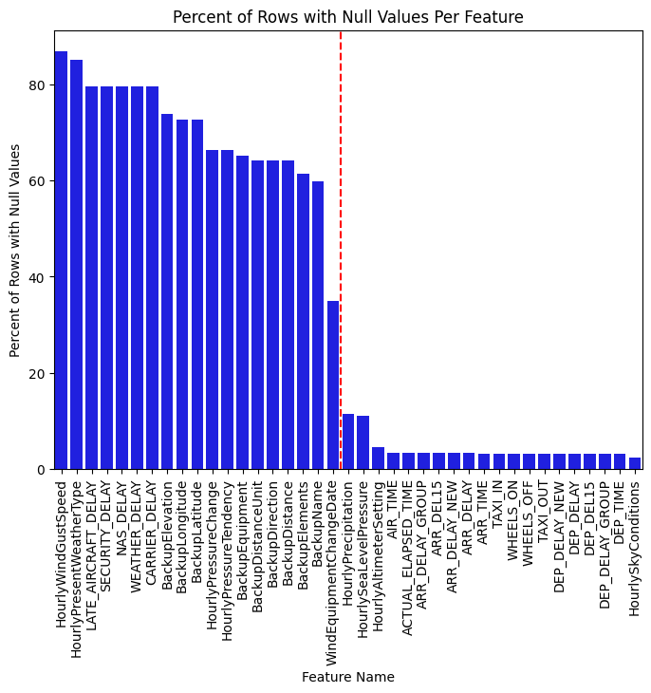
Missing Values
Initial Inspection of Missing Values showed that 108 features had missing values above 30%.
We removed features that had information about future events to prevent leakage (Flight Arrival Status, Taxi time, Any information about the delay, etc.)
To avoid assumptions about the underlying distribution of features, we decided to impute a “missing” category or a “-1” for numeric data.
Notes:
AUTHOR: KENNETH

Slide 15
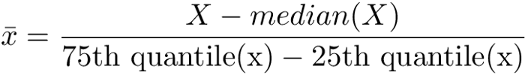
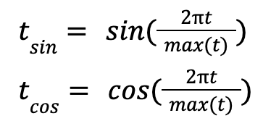
Time Series and Numeric Features
Time Series Features that we already have: Quarter, Month, Day of Week, Day of Month of Departing Flight
Time Series Features needing further processing: Scheduled Departure Datetime, Four Hours Before Departure Datetime, Two Hours Before Departure Datetime, Weather Station Datetime (4 hours before departure).
Extract only the hour and minute from these datetimes.
Cyclically encode temporal features.
Preserves periodicity of the features so the model can learn continuous temporal patterns (weekly, monthly, quarterly, etc)
Added benefit of keeping the range of values from [-1, 1]
For Numeric Features, utilize a RobustScalar to scale all columns based on the median and interquartile range.
Notes:
AUTHOR: KENNETH

Slide 16
Categorical Features
HourlySkyConditions transformed to 3 features: HourlyCloudCoverage (str), HourlyCloudLayerAmount (str), and HourlyCloudBaseHeight (float)
HourlyCloudCoverage is the description of the clouds (CLR = clear day, OVC = overcast, etc.)
HourlyCloudLayerAmount: number of eighths that the sky is covered by (treated as a categorical variable)
HourlyCloudBaseHeight: The height of the lowest layer of clouds in ft.
We then one hot encoded all the categorical features, leading to a vector of 13591 different features.
Will utilize LASSO in order to select the most relevant features.
Notes:
AUTHOR: KENNETH

Slide 17
LASSO Feature Selection
Used Logistic Regression with Lasso (L1) Regularization to reduce many of the feature weights to 0 and utilize only the ones remaining.
Remaining Numeric Columns:
Travel Distance, Longitude, Hourly Relative Humidity, Hourly Visibility, and Hourly Wind Speed
Remaining Time Columns:
Day of month, day of week, month, scheduled departure time.
Remaining Categorical One-Hot Columns:
Carriers: DL, OO, EV, UA, AS, NK, HA
Origin Airports: 10397, 11298, 10821, 11259
Origin States: IL, GA, HI, MD, NY
Origin Stations: 72219013874, 72259003927, 72406093721, 72258013960
Origin Airport Type: Large Airport
Hourly Cloud Coverage: OVC (overcast)
Hourly Cloud Layer Amount: 8 (8/8 of the visible sky is covered)
Notes:
AUTHOR: BEN
Once we finished preprocessing and one-hot encoding, our feature space exploded to over 13,000 features.
Clearly, not all of these would be helpful for our model, and using all of them would introduce noise, overfitting, and unnecessary computation.
So, we applied LASSO, or L1 regularization, with logistic regression. LASSO helps by shrinking the coefficients of less relevant features close to zero.
As a result, we were able to narrow down our feature set dramatically.
You can see in the lower left the numeric and time-related features that remained.
Some interesting points to note regarding our remaining categorical columns was that origin information seemed way more influential over destination information,
and among the categorical weather features, overcast cloudy days seemed to be most relevant to delays, which aligns with our intuition.
This reduced feature space helped us streamline our workflow and slightly improved generalization.

Slide 18
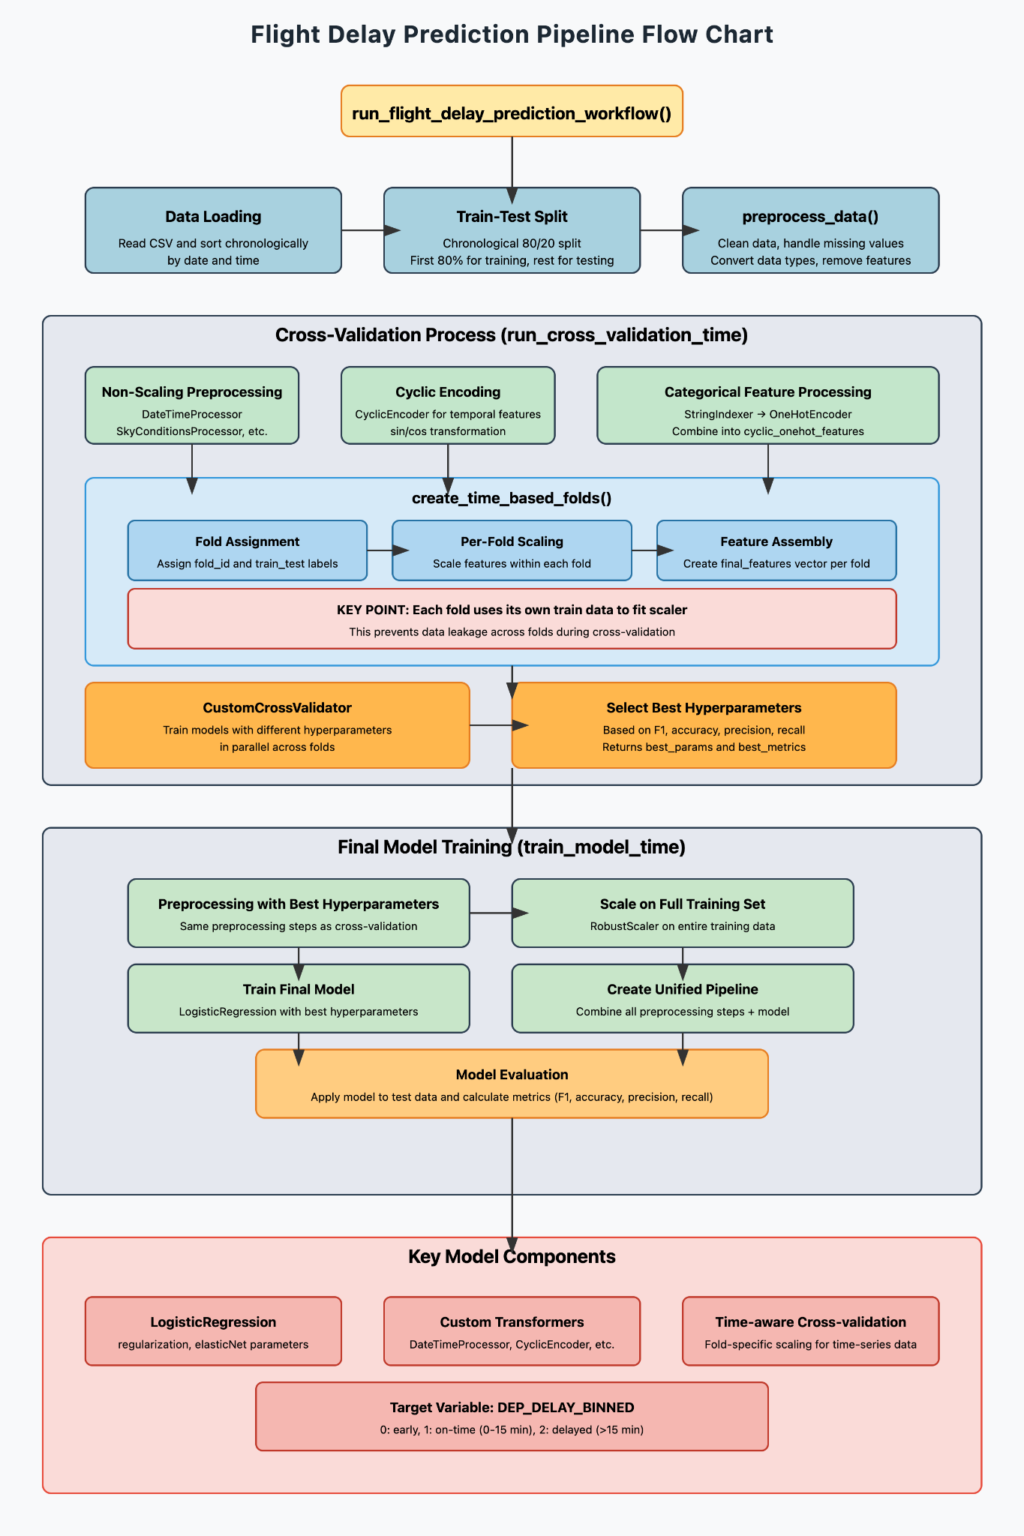
ML Pipeline: Overview
Data loading & Cleaning
Feature engineering
Time-based Cross-validation
Feature Scaling and Transformation
Model Training with Hyperparameter Tuning (Grid Search)
Final model Integration
Evaluation
Notes:
AUTHOR: BEN
As described in our preprocessing, our ML pipeline not only had to train a model, but also handled messy data, temporal patterns, and categorical variables.
We broke the pipeline down into seven key stages:
Data Loading & Cleaning included dropping high null count features.
Feature Engineering included creating time-based variables and weather indicators.
Time-Based Cross-Validation was used on blocked folds in the training set to avoid information leakage.
The Feature Scaling & Transformation stage applied scaling and encoding for features.
Model Training with Hyperparameter Tuning is where grid search across our models was done.
In Final Model Integration, our selected model is bundled with the previous stages into a unified PipelineModel.
Finally, in Evaluation, We track model performance using metrics like F1 score.
The pipeline implementation for our logistic regression model can be seen in the diagram, but the other models we tested follow the same flow.
However, our pipelines often seem to take several hours to complete all stages, so we will also aim to explore more performance optimizations.

Slide 19
ML Pipeline: Feature Families
Temporal Features (12 features)
Year, Month, Quarter, Day of Month, Day of Week
Scheduled departure hour/minute
Four hours prior departure hour/minute
Two hours prior departure hour/minute
Station hour/minute
Weather Features (10 features)
HourlyAltimeterSetting, HourlyDewPointTemperature
HourlyPrecipitation, HourlyRelativeHumidity
HourlyVisibility, HourlyWindDirection
HourlyWindSpeed, HourlyCloudCoverage
HourlyCloudLayerAmount, HourlyCloudBaseHeight
Geographical Features (8 features)
Origin/Destination Airport IDs
Origin/Destination State
Origin/Destination station distances
Latitude, Longitude, Elevation
Flight-specific Features (5 features)
Carrier, Carrier ID, Flight Number
Distance, Distance Group
Notes:
AUTHOR: BEN

Slide 20
Key Implementation Notes
Custom Transformers
Our pipeline uses several custom transformers for effective feature engineering:
DateTimeProcessor: Extracts meaningful temporal features
SkyConditionsProcessor: Processes complex weather data
CyclicEncoder: Applies sine/cosine transformations to cyclical features
Time-Based Cross-Validation
We also use chronological splits of data instead of random shuffling
Maintains temporal integrity by fitting scalers on training portions only
Prevents data leakage across time boundaries
Feature Transformations
We utilize various feature transformations depending on the type of feature
Categorical features: String indexing and one-hot encoding
Temporal features: Cyclic encoding using sine/cosine transformations
Numerical features: Robust scaling for outlier handling
Notes:
AUTHOR: BEN
Let me highlight a few implementation details that were especially important in our pipeline workflow:
We built custom transformers to streamline feature engineering.
These help perform the preprocessing described by Kenneth earlier.
We also carefully handled time-based splits for cross-validation. Kent will cover this in more detail in the next section,
but instead of random shuffling, we used blocked cross-validation to ensure that each train and test split respected chronological order.
For our models to use the processed data:
Categorical features went through string indexing or one-hot encoding.
Temporal features were cyclically encoded.
And Numerical features were scaled using the RobustScaler, which is less sensitive to outliers compared to standard scaling.
Overall, these engineering and modeling choices helped us build a robust foundation that respects the nature of the data.

Slide 21
1.
Project Description
2.
Exploratory Data Analysis
3.
Preprocessing/Pipeline
4.
Cross-Validation and Fine-Tuning
5.
Model Results
6.
Conclusion
Notes:
Handing it over to Kent

Slide 22
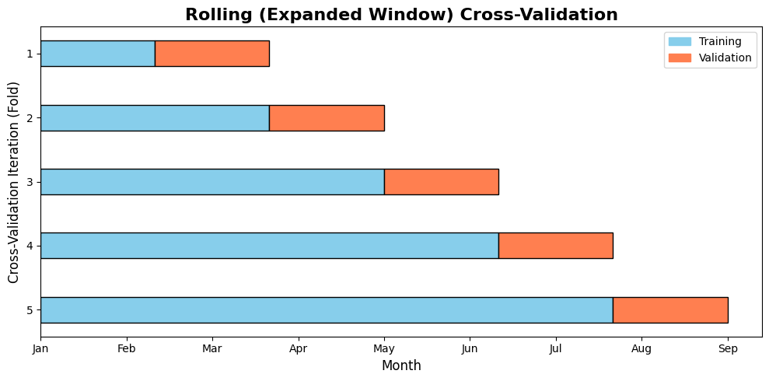
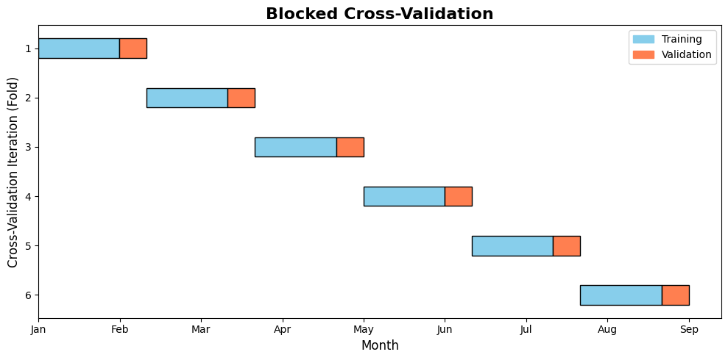
Blocked Cross-Validation (Time-Series)
Why Cross-Validation?
Tunes hyperparameters systematically and evaluates model performance robustly.
Reduces overfitting risk by avoiding a single train–test split.
Time-Series Cross-Validation Approaches:
Rolling (Expanding Window) CV:
Training set expands sequentially; validation always follows.
Overlapping sets may lead to data leakage.
Blocked (Non-Overlapping) CV:
Uses non-overlapping folds with margins to separate training and validation.
Strictly respects chronological order, preventing leakage and ensuring reliable evaluation.
Notes:
Speaker Notes (Kent): I am want to talk about the rationale behind using cross-validation in our project.
First, we have Why Cross-Validation?
To determine what are the optimal hyperparameters for our models, and also to evaluate our model performance
Testing on diverse data segments minimizes overfitting and improves the model’s ability to generalize.
Since our data can be considered time-dependent, we need cross-validation methods that respect the chronological order. We can consider two main approaches:
Rolling (Expanding Window) CV:
The training set gradually grows with time, and the validation set always immediately follows.
However due to the overlapping windows, information from the future could be leak into training, potentially overestimating performance.
Blocked (Non-Overlapping) CV:
Data is split into distinct, non-overlapping folds with a gap (margin) between the training and validation sets.
This approach ensures that no data point is used both as a predictor and as a target, strictly preserving the chronological order and preventing leakage.
For our Project, we choose Blocked Cross-Validation over Rolling Cross-Validation not just because it prevents data leakage, but because it is more computationally efficient. Unlike Rolling CV, where the training window continuously expands, Blocked CV uses fixed-size windows, which reducing processing overhead.

Slide 23
Blocked Cross-Validation (Time-Series)
Our Project's Approach:
Step 1: Data Partitioning
Use the first three quarters of our 12-month dataset.
Partition the data into non-overlapping folds (Blocked CV) that preserve the chronological order.
Step 2: Custom Cross-Validation Setup
Implement a custom cross-validation class that lets you specify:
The number of folds
The training ratio for each fold
The model and hyperparameter grid
The evaluation metrics
Apply robust scaling on numerical features from the training subset only to prevent data leakage.
Step 3: Training & Evaluation
For each fold:
Split data into training and test sets based on the defined ratio.
For each hyperparameter combination, train the model on the training set and evaluate on the test set.
Compute metrics (e.g., F1-score, accuracy) for each fold.
Average the metrics across folds and select the hyperparameter combination with the best average score.
Blocked Cross Validation
Optimal Hyperparameters
First Three Quarter Data
Notes:
Speaker Notes (Kent):
The cross-validation process in our project can be outlined in three key steps:
Step 1: Data Partitioning We begin by using the first three quarters of our 12-month dataset, applying Blocked Cross-Validation to create non-overlapping folds while preserving the chronological order
Step 2: Custom Cross-Validation Setup Next, we implement a custom cross-validation class. This class lets us specify important parameters such as:
The number of folds,
The training ratio for each fold,
The model to be used along with a hyperparameter grid, and
The evaluation metrics.
Also, when an instance of this class is initialized, a RobustScaler is automatically fit on each fold’s training subset and then applied to both the training and test data.
Step 3: Training & Evaluation In the final step, for each fold:
We split the data into training and test sets based on our defined ratio.
For each hyperparameter combination in our grid, the model is trained on the training set and evaluated on the test set concurrently for each fold.
We compute evaluation metrics like F1-score and accuracy for each fold and for each hyperparameter combination
After computing metrics for each fold and every hyperparameter combination, we average these scores across folds to identify the best-performing combination.
We select the best hyperparameter combination based on the primary metric specified by the user.
In other words, the user defines which metric is most important, and we choose the parameter set that achieves the highest score for that metric.
The optimal hyperparameters are then used to train a final model on the complete three-quarter training dataset (processed as a whole), which is subsequently used to make predictions on the test data (the last quarter).

Slide 24
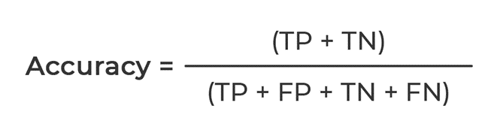
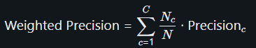
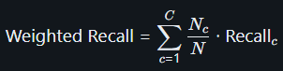
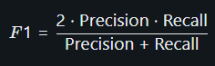
Metrics Used
Accuracy: Measures the overall correctness of our model's predictions. It is defined as the ratio of the number of correct predictions to the total number of predictions made.
Weighted Precision: Computes precision for each class (early, on-time, delayed) and then averages them using weights based on the number of instances in each class. This helps account for class imbalances.
Weighted Recall: Calculates the recall (sensitivity) for each class, which is the fraction of actual instances correctly predicted, and averages these scores with weights proportional to the class frequencies.
F1 Score: Represents the harmonic mean of precision and recall for each class. The weighted F1 score averages these values according to each class's prevalence, providing a balanced measure of performance that considers both false positives and false negatives.
Notes:
Speaker Notes (Kent): So in terms of the metrics that we will be using to evaluate our model and determine the optimal hyperparameters in our cross-validation phase, we have:
Accuracy: Measures the overall correctness of our model's predictions..
Weighted Precision: Computes precision for each class (early, on-time, delayed) and averages them using class frequency weights to address imbalance.
Weighted Recall: Calculates the proportion of actual positives correctly identified for each class and averages these values with weights based on class sizes.
F1 Score: The harmonic mean of precision and recall, averaged across classes to provide a balanced measure of model performance.

Slide 25
1.
Project Description
2.
Exploratory Data Analysis
3.
Preprocessing/Pipeline
4.
Cross-Validation and Fine-Tuning
5.
Model Results
6.
Conclusion
Notes:
AUTHOR: EDGAR

Slide 26
Model Comparisons Across Evaluation Metrics
Decision Tree Classifier used as a baseline due to simplicity and interpretability
Logistic Regression hyperparameters selected via grid search across: Lasso/Ridge/ElasticNet
Random Forest tuned with a small grid to manage runtime while balancing performance
Model | Train F1 | Train Precision | Train Recall | Train Accuracy | Test F1 | Test Precision | Test Recall | Test Accuracy
Decision Tree | 0.470 | 0.445 | 0.570 | 0.570 | 0.505 | 0.460 | 0.586 | 0.586
Logistic Regression | 0.520 | 0.525 | 0.582 | 0.582 | 0.537 | 0.523 | 0.561 | 0.561
Random Forest | 0.4240 | 0.4492 | 0.5762 | 0.5762 | 0.4461 | 0.3562 | 0.5968 | 0.5968
Random Forest (with Lasso Feature Selection) | 0.4490 | 0.4935 | 0.5715 | 0.5715 | 0.4597 | 0.4297 | 0.5958 | 0.5958
Notes:
AUTHOR: EDGAR

Slide 27
Best Hyperparameters & Takeaways
Model | Hyperparameters
Decision Tree (Baseline) | maxDepth = 3
Logistic Regression | regParam=0.001, elasticNetParam=0.0
Random Forest | numTrees=20, maxDepth=15
Random Forest (w/LASSO) | numTrees=5, maxDepth=5
Key Takeaways
Decision Tree, while a baseline model, performed competitively and provided interpretability
Logistic Regression achieved the highest overall performance, especially in F1 and precision on the blind test
Random Forest has strong recall and accuracy but low precision, which indicates overprediction on the majority class
Random Forest with Lasso-selected features slightly improved precision and F1 on the test set, suggesting feature reduction helped generalization.
Notes:
AUTHOR: EDGAR

Slide 28
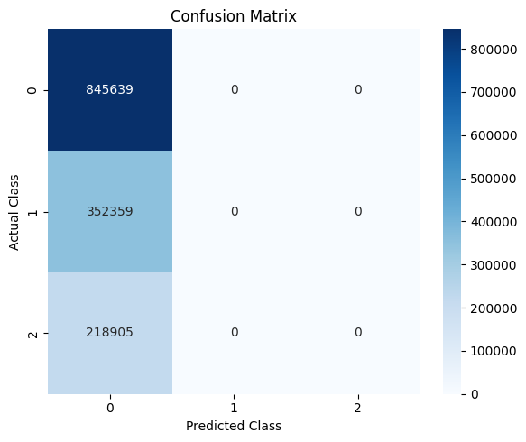
Confusion Matrix & Class Imbalance
Confusion Matrix - Random Forest on Blind Test Set
0=Early, 1=On-Time, 2=Delayed
All predictions fall into the majority class, Class 0 (Early), with no predictions made for Class 1 (On-Time) or Class 2 (Delayed).
Poor generalization to delayed flights
Precision likely affected due to class imbalance
Also important is improving model recall across all classes
In future iterations, SMOTE (Synthetic Minority Over-sampling Technique) will be considered as a resampling strategy to help balance classes & improve generalization for delayed flights.
Notes:
AUTHOR: EDGAR

Slide 29
1.
Project Description
2.
Exploratory Data Analysis
3.
Preprocessing/Pipeline
4.
Cross-Validation and Fine-Tuning
5.
Model Results
6.
Conclusion

Slide 30
Conclusion
Next Steps for Phase 3
Our best model was Logistic Regression with light L2 regularization (regParam = 0.001, elasticNetParam=0.0). The overall F1 score performance was 0.537, with many opportunities for improvement.
With the pipeline created and implemented along with cross-validation for time series, our team expects to improve the overall performance of our model with the following next steps:
Improve Feature Engineering
Determine better way to transform geographic data (Latitude, Longitude, Elevation)
Review how different imputation techniques affect performance (median/mean imputation, KNN imputation, etc).
Implement Principal Component Analysis to reduce our extremely large vector space.
Test out SMOTE to better deal with imbalanced classes.
Implement Neural Networks to determine if there is any performance improvement.
Notes:
AUTHOR: ADAM
As Edgar just mentioned, our best model was Logistic Regression with L2 regularization.
The overall F1 score performance was .537, suggesting that we have moderate predictive ability. This gives us many opportunities for improvement.
In the next phase we are looking to do a few things to improve upon on our current solution:
First, we’d like to see if we can extract more predictive information through different feature engineering techniques:
To start, we’d like to experiment with different transformations of geographic features - specifically using pagerank to rank departure and arrival locations.
Additionally, we’re reviewing how different imputation techniques might improve performance.
Lastly, we’d like implement PCA to reduce our vector space.
Outside of engineering new features, we’d like to test out SMOTE as a way to handle our imbalanced classes better.
As a final way to improve performance, we’re exploring new algorithms - specifically, we’d like to implement a neural network to determine if we can capture more of the complexities in the data.

